Slide 1
AIR QUALITY MONITOR
ESP32, WINSEN ZPHS01B, NEXTION NX4827K043_011

Slide 2
Component
- ESP 32 (controller)
- WINSEN ZPHS01B (Multi-in-OneSensorModule )
- NEXTION NX4827K043_011 (Display)
- Voltage Converter
Laser dust sensor
Infrared carbon dioxide sensor
Electrochemical formaldehyde sensor,
Electrochemical ozone sensor, electrochemical carbon Monoxide sensor
VOC sensor,
NO2 sensor
Temperature and Humidity sensor.

Slide 3
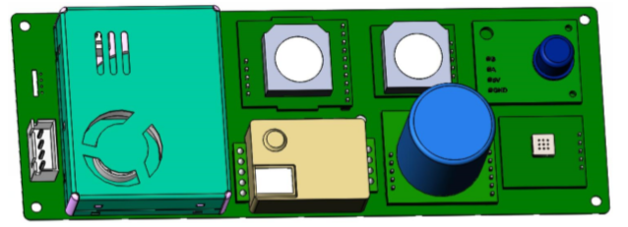
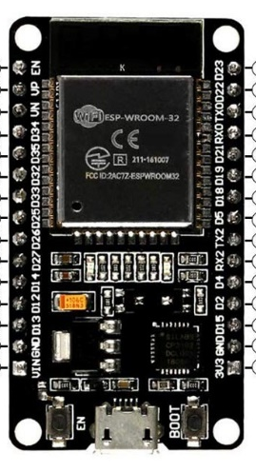
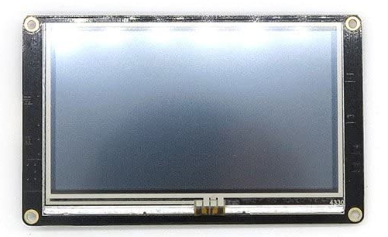
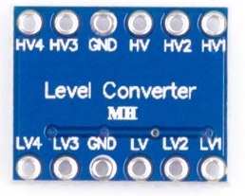
Circuit
ESP | Winsen | Nextion | Converter
GND | GND | GND | GND
Vin | Vcc | Vcc | HV
3,3 V | - | - | LV
D4 (RX1) | TX | - | -
D2 (TX1) | RX | - | -
- | - | RX | H4
- | - | TX | H3
D16(RX) | - | - | LV3
D17(TX) | - | - | LV4

Slide 4
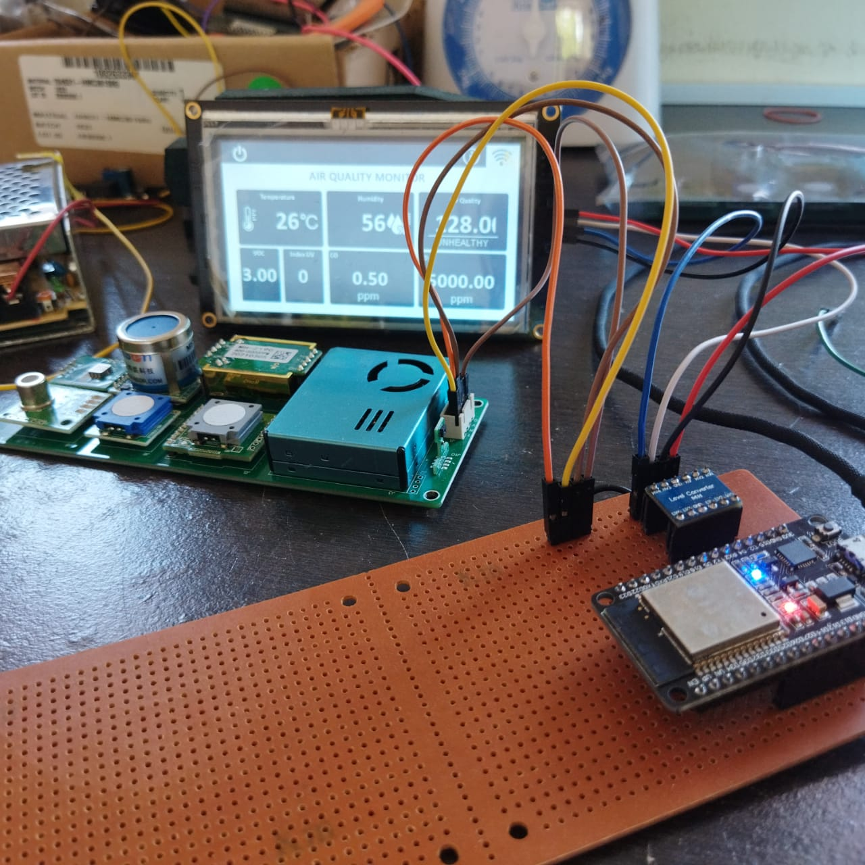
Fitur Already done
Can display and Post of value :
Laser dust sensor
Infrared carbon dioxide sensor
Electrochemical formaldehyde sensor,
Electrochemical ozone sensor, electrochemical carbon Monoxide sensor
VOC sensor,
NO2 sensor
Temperature and Humidity sensor.
Can scan wifi
Auto connect with saved SSID WiFi

Slide 5
Fitur Not ready yet
Sensor UV
Code scan and save wifi for new esp

